Slide 1
Database Management System
CSCE 315: Project 3 | Team 2
Russell Pier | Ellie Miller | Cole Boggus | Liuyi Jin

Slide 2
AGILE PROGRAMMING
Weekly Sprint meetings
Daily Scrum meetings

Slide 3
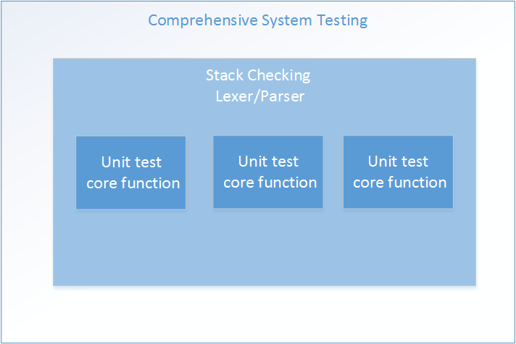
TEST-DRIVEN DESIGN
Unit testing
Parser system testing
Comprehensive unit testing

Slide 4
Design
Parser/Lexer
ANTLR
Visitor
Database
Core functions
RelationTable
Condition

Slide 5
BURN-DOWN CHARTS
Pre-production
Post-production

Slide 6
DATABASE FUNCTIONS
Relation Table
Relation name
Attribute names, types
Tuples
Database
Memory
Command functions
Query functions

Slide 7
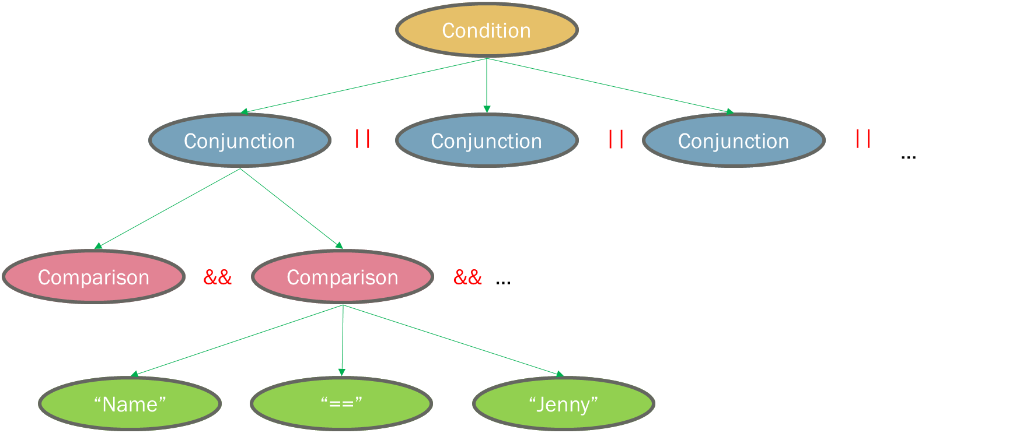
CONDITIONS
Condition
Conjunction
Comparison

Slide 8
video

